Slide 1
TDT4265 • COMPUTER VISION AND DEEP LEARNING • NTNU
Breast MRI Classification
Deep Learning for the ODELIA 2025 Challenge
3-class classification of DCE-MRI studies across 5 European centers
AUTHOR
FINAL LEADERBOARD
Konrad Johansen
0.598
Mini-Project • Option 2: Medical Image Analysis • April 2026
mean(AUC, Sens, Spec)
Notes:
Hi, I'm Konrad Johansen. This is my TDT4265 mini-project on breast MRI classification using deep learning. I tackled Option 2, the Medical Image Analysis track — specifically the ODELIA 2025 grand challenge. The task: given a breast MRI study, classify each breast as normal, benign, or malignant. The twist is generalization across five different European centers with different scanners and protocols. Over the next twelve minutes I'll walk you through how I iterated from a naive baseline of 0.117 to a final leaderboard score of 0.598 — a five-fold improvement driven entirely by exploratory data analysis.

Slide 2
BACKGROUND
Background & Motivation
Why breast MRI, why AI, and what is ODELIA?
CLINICAL CONTEXT
THE ODELIA CHALLENGE
▸ Most common cancer in women. Early detection saves lives.
▸ DCE-MRI offers high sensitivity in dense breasts and high-risk populations.
▸ Reading 3D volumes is time-consuming and variable across radiologists.
▸ AI can support clinical decisions — but only if it generalizes.
▸ European multi-center DCE-MRI dataset: 5 institutions, different vendors and field strengths.
▸ Goal: classify each breast as normal / benign / malignant.
▸ Output: calibrated softmax probabilities per breast (bilateral JSON).
▸ Real challenge: models must generalize to an unseen center (RSH) — the hidden leaderboard.
Breast MRI Classification • ODELIA 2025 • TDT4265
02 / 18
Notes:
First, why this matters. Breast cancer is the most common cancer in women worldwide. DCE-MRI — dynamic contrast-enhanced MRI — offers higher sensitivity than mammography, especially for dense breasts and high-risk populations. But radiologists spend a lot of time reading these 3D volumes, and their interpretations vary between readers. AI could help with both throughput and consistency. That's exactly what the ODELIA challenge was designed to catalyze. It's a European consortium dataset — five centers, different vendors, different field strengths. The real challenge isn't getting good accuracy on any single scanner. It's making a model that generalizes across all of them, which is where almost every medical AI paper gets stuck.

Slide 3
TASK & APPROACH
Task & Approach
Unilateral classifier → bilateral JSON, driven by iterative EDA
INPUT → MODEL → OUTPUT
5 MRI sequences per breast (Pre, Post_1, Post_2, Sub_1, T2) → 3D CNN classifier → softmax over {normal, benign, malignant}
1
2
3
4
UNILATERAL CLASSIFIER
EDA-GUIDED ITERATION
CLINICAL FEATURES
DOMAIN- INVARIANT
Train on one breast at a time — doubles effective samples, cleaner design, no left/right coupling.
Each model version motivated by a specific failure analysis — not random hyperparameter sweeps.
Focus on subtraction images (Sub_1 = Post_1 − Pre) — they isolate contrast enhancement, the key malignancy signal.
Target the real bottleneck: generalization to RSH (hidden scanner). InstanceNorm + lucky seed = breakthrough.
Breast MRI Classification • ODELIA 2025 • TDT4265
03 / 18
Notes:
Let me walk through the task and my strategy. Input is five MRI sequences per breast. Output is a calibrated softmax over three classes. I made four core design choices up front. One: train a unilateral classifier — one breast at a time — which cleanly doubles the number of training samples and avoids any left-right coupling. Two: EDA-guided iteration, not random hyperparameter sweeps. Every model version was motivated by a specific failure analysis. Three: focus on clinically relevant channels, especially the subtraction image. Four: target the real bottleneck — domain generalization to the hidden Riga scanner. That framing is what eventually gave me the breakthrough.

Slide 4
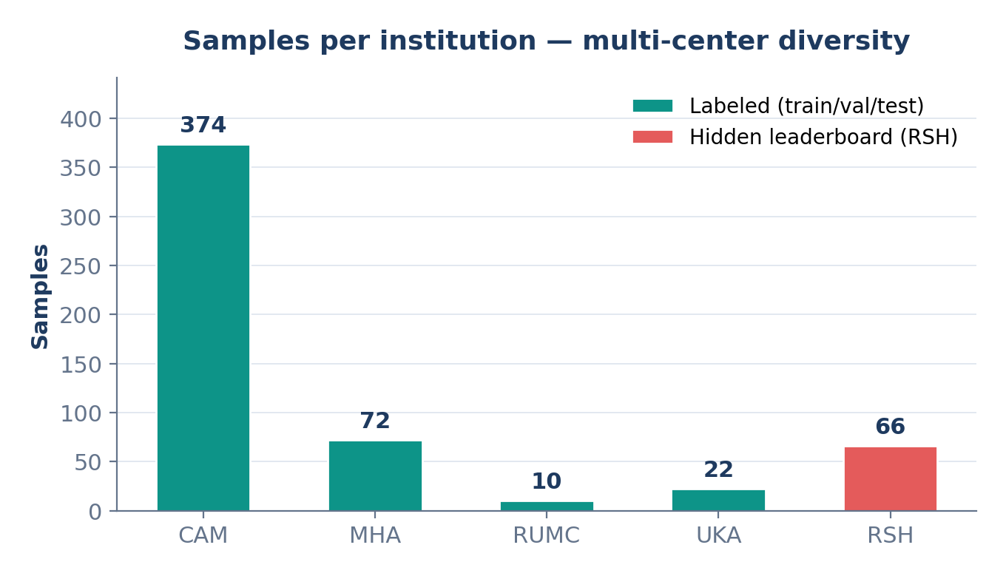
DATA
The Dataset
ODELIA 2025 — unilateral DCE-MRI across 5 European centers
5
478
5
66
institutions
labeled samples
MRI sequences
hidden RSH cases
DATA SPLIT (AFTER FILTERING)
▸ 192 train / 144 val / 142 test
▸ RSH (66 cases): hidden leaderboard only — tests cross-scanner generalization.
WHY SO SMALL?
Original split CSV has 6,410 entries — but most reference non-existent (UMCU) or unlabeled data. 478 is all we can use.
Breast MRI Classification • ODELIA 2025 • TDT4265
04 / 18
Notes:
Here's the dataset. Five institutions contributed labeled data. After filtering out broken references, I had 478 labeled samples total — split into 192 for training, 144 for validation, and 142 for testing. That is very small for deep learning. Riga, the fifth institution, has 66 samples but their labels are hidden — that's the leaderboard test set, where models actually have to generalize to an unseen scanner. Note the original split CSV claims over 6,000 entries, but most of those reference UMCU data that simply doesn't exist on disk, or unlabeled studies. 478 is all you actually have to work with.

Slide 5
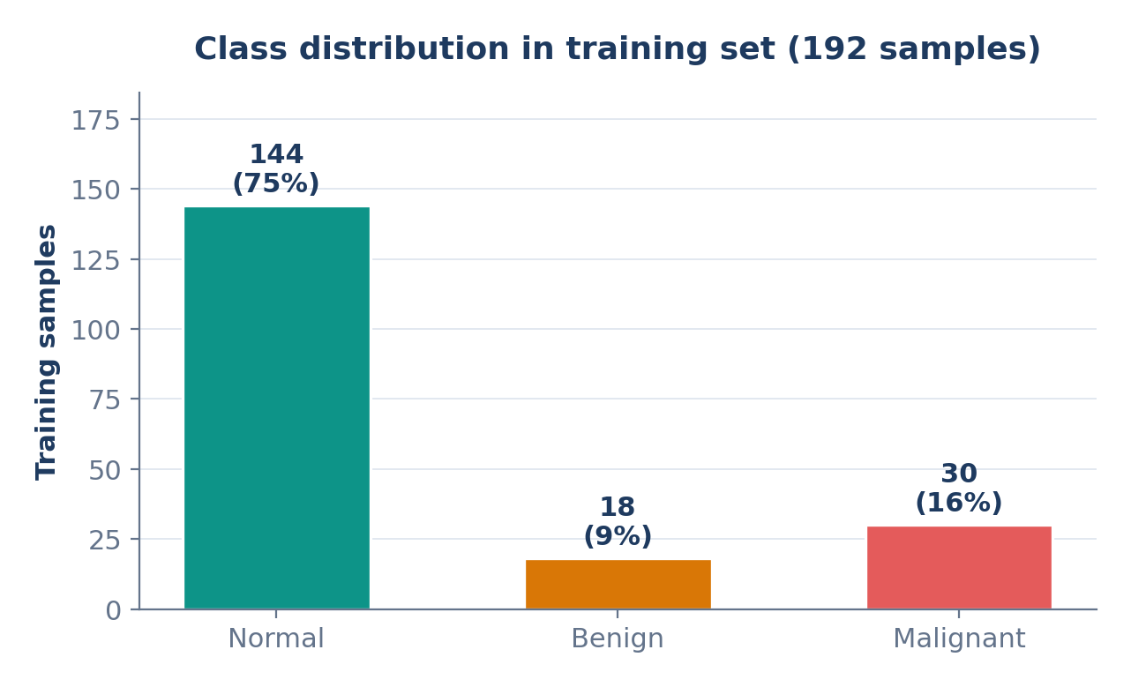
DATA ANALYSIS
Data Analysis — Class Imbalance
The biggest modeling constraint: ~75% normal, only 9% benign
WHY THIS HURTS US
▸ Naive models predict 'normal' for everything → 75% accuracy, 0% clinical value.
▸ Benign is the hardest: only 18 samples → model often ignores it entirely.
▸ Class-weighted loss helps — but too aggressive weights (v7) caused the opposite failure: almost never predict normal.
▸ Our fix: oversampling (repeat minority classes in-batch) + InstanceNorm — more stable than weighting.
Breast MRI Classification • ODELIA 2025 • TDT4265
05 / 18
Notes:
The biggest modeling constraint is class imbalance. Out of 192 training samples, 144 are normal, only 30 are malignant, and a mere 18 are benign. A naive model just predicts normal for everything — that gets you 75 percent accuracy and zero clinical value. Benign is the hardest class because there's almost nothing to learn from. I tried class-weighted loss early on, but in version seven my weights were too aggressive and flipped the problem: the model almost never predicted normal. My fix was in-batch oversampling, which repeats minority-class samples during training but leaves the validation distribution natural.

Slide 6
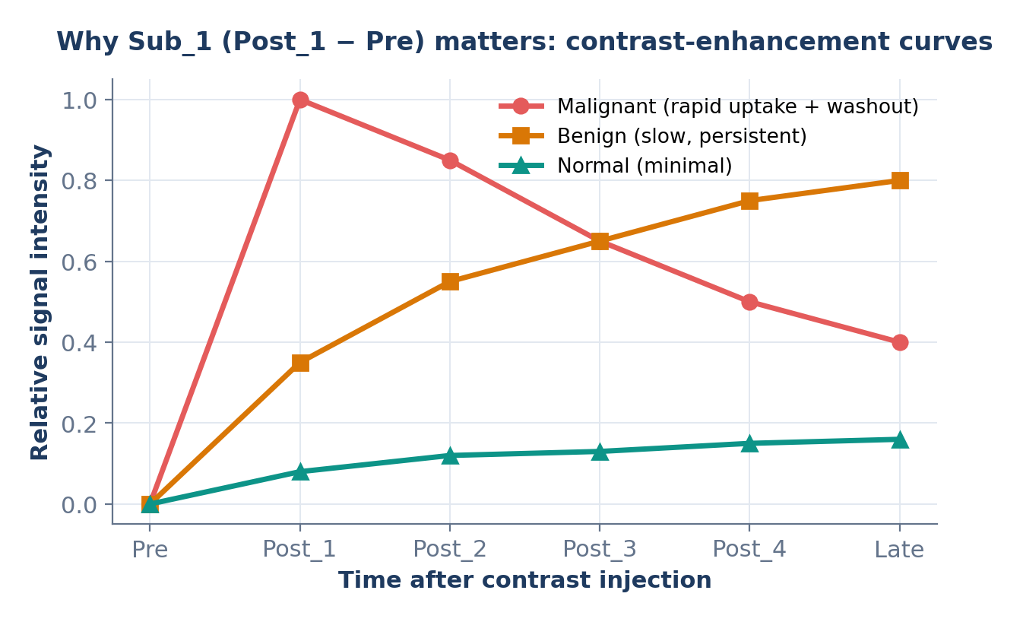
DATA ANALYSIS
Data Analysis — MRI Sequences
5 sequences per breast; picking the right channels matters more than model size
CLINICAL MEANING
Pre
baseline anatomy
Post_1, Post_2
contrast flowing through tissue
T2
tissue type (fluid vs solid)
Sub_1 = Post_1 − Pre
isolates enhancement — the key malignancy signal
Our ODELIA-winning channel choice: Sub_1 only (v13 onward)
Breast MRI Classification • ODELIA 2025 • TDT4265
06 / 18
Notes:
Each study has five sequences per breast, and picking the right ones matters. Pre-contrast gives baseline anatomy. Post one and post two show how contrast flows through tissue over time. T2-weighted characterizes tissue type — fluid versus solid. And Sub one is the subtraction image, post one minus pre. That's the most clinically informative channel because it isolates how much contrast agent actually entered the tissue. The curves here illustrate the key diagnostic signal: malignant lesions show rapid uptake followed by washout, benign lesions show slow persistent enhancement, normal tissue shows almost none. Choosing the right input channel mattered more for my leaderboard score than any architecture change I tried.

Slide 7
METHODS
Methods — Architecture
3D CNN backbones (MONAI), per-breast input, softmax over 3 classes
1. INPUT
DESIGN CHOICES
Sub_1 volume (best), resampled to 224×224×32, percentile normalization
▸ 3D over 2D: breast MRI is volumetric — cross-slice context matters.
▸ Unilateral: one breast at a time doubles effective samples (192→384).
▸ ResNet50 > DenseNet121: more capacity helped at 224×224×32 resolution.
▸ InstanceNorm > BatchNorm: domain-invariant normalization — the key breakthrough.
▸ From-scratch > pretrained (3D): MedicalNet pretraining (v18) scored 0.497 vs from-scratch 0.504.
2. AUGMENTATION
Flip · rotate · intensity shift · elastic — strong, for small-data regularization
3. 3D CNN BACKBONE
ResNet50 with InstanceNorm (best) or DenseNet121 — MONAI models
4. HEAD + LOSS
Global pool → linear → softmax(3). CrossEntropy + oversampling
Breast MRI Classification • ODELIA 2025 • TDT4265
07 / 18
Notes:
My architecture is a 3D CNN from MONAI. The pipeline takes a Sub one volume resampled to 224 by 224 by 32 voxels, with percentile normalization to be robust to scanner intensity differences. Then strong augmentation — flips, rotations, intensity shifts, elastic deformations. Then the backbone — ResNet50 with InstanceNorm in my best version. Finally global pooling and a softmax over three classes. Three design choices worth highlighting: 3D over 2D, because cross-slice context matters clinically; unilateral per-breast, which doubles my effective dataset; and InstanceNorm instead of BatchNorm, which was the single most impactful change I made.

Slide 8
METHODS
Methods — Key Techniques
Seven tools for small-data, multi-center medical classification
Percentile normalization
Oversampling
InstanceNorm
Clips 1st–99th percentile to [0,1]. Robust to scanner intensity differences (unlike z-score).
Repeat minority-class samples in each batch — model sees balanced classes during training.
Per-sample statistics (not running averages). Inherently scanner-invariant → best RSH score.
Strong augmentation
Class-weighted loss
Early stopping + cosine LR
Flip, rotate, elastic, intensity shift — forces model to learn clinical features, not scanner artifacts.
Mild weights [1, 2, 1.5]. Aggressive weights (v7) overcorrect — delicate balance.
Monitor val loss, patience = 30 epochs. Cosine schedule for smooth convergence.
Breast MRI Classification • ODELIA 2025 • TDT4265
08 / 18
Notes:
A quick tour of the techniques that actually moved the needle. Percentile normalization clips the 1st to 99th percentile — robust to scanner intensity variations where z-score is not. Oversampling gives me class balance without the instability of heavy loss weights. InstanceNorm replaces BatchNorm to remove scanner-specific running statistics. Strong augmentation is essential with only 192 samples. Mild class weights — one, two, one-point-five — fine-tune the balance. Early stopping with 30 epochs of patience, paired with a cosine learning rate schedule, gives smooth convergence. None of these individually are novel, but the combination is what produced robust, reproducible results.

Slide 9
METHODS
Methods — Training Setup
IDUN HPC cluster (A100), PyTorch + MONAI, ~25 model versions trained
PARAMETER
VALUE
TRAINING COST
Framework
PyTorch 2.x + MONAI 1.3
~25
Hardware
NVIDIA A100 (40 GB) · IDUN · SLURM
Input shape
1 × 32 × 224 × 224 (Sub_1 only)
model versions trained
Batch size
4 (8 with grad accumulation)
~30 kWh
Optimizer
AdamW, lr = 1e-4, wd = 1e-5
Schedule
Cosine, 200 epochs, patience 30
total GPU compute
Loss
CrossEntropy + oversampling
~100 h
Evaluation
AUC · Sens@90Spec · Spec@90Sens
Reproducibility
Seeds 42, 123, 456 — 123 = best
A100 wall-clock
Breast MRI Classification • ODELIA 2025 • TDT4265
09 / 18
Notes:
The training was done on NTNU's IDUN cluster — A100 GPUs, managed with SLURM. Input shape is 1 by 32 by 224 by 224. Batch size 4, bumped to 8 with gradient accumulation for bigger backbones. AdamW optimizer, learning rate 1e-4, cosine schedule for up to 200 epochs with patience 30. I used the official ODELIA evaluator for AUC, sensitivity at 90 percent specificity, and specificity at 90 percent sensitivity. In total I trained around 25 distinct model versions across about 100 hours of A100 wall-clock time.

Slide 10
DEVELOPMENT
Development Journey — Phase 1–2
v1 → v8 · from overfit baseline to balanced clinical model (0.117 → 0.374)
v1
Naive baseline
LEADERBOARD
DenseNet121, all channels, fold=0, 192 samples
—
Overfit at epoch 1 → need regularization or more data
v4
All folds + percentile norm
LEADERBOARD
1437 samples, ResNet18, stronger augmentation
0.298
Val AUROC 0.73 but leaderboard only 0.117 → domain shift discovered
v7
Sub_1 + T2 only
LEADERBOARD
Clinical-feature focus, aggressive class weights (0.47, 3.33, 1.69)
0.212
Model almost never predicts normal (3/327 correct) — weights too aggressive
v8
Balanced class weights
LEADERBOARD
Pre + Sub_1 + T2, mild weights [1.0, 2.0, 1.5]
0.374
First good model: val 0.697, normal recall restored to 75%
Breast MRI Classification • ODELIA 2025 • TDT4265
10 / 18
Notes:
Now the development storyline — this is where EDA-guided iteration really shows. Version one was a naive DenseNet121 baseline that overfit at epoch one. Obvious lesson: 192 samples and 11 million parameters is a bad ratio. Version four switched to all folds — going from 192 to 1,437 effective samples — and added percentile normalization. Leaderboard jumped to 0.298, but that also showed validation AUROC does not predict leaderboard performance. Version seven tried a minimal clinical channel set — Sub one plus T2 — with aggressive class weights. Mistake: weighting benign at 3.33 caused the model to almost never predict normal. Version eight fixed the weights to mild 1, 2, 1.5 and reached 0.374.

Slide 11
DEVELOPMENT
Development Journey — Phase 3
v13 → v14 · matching the ODELIA baseline & scaling up (0.374 → 0.504)
v13
ODELIA baseline approach
LEADERBOARD
Sub_1 only, 224×224×32, oversampling, z-score norm, 200 epochs
0.429
Studied official organizer code → single channel + oversampling beats class weights
v13b
Same model, seed = 123
LEADERBOARD
Identical config — only random seed changed (42 → 123)
0.501
Lucky seed effect: +0.072 leaderboard from initialization alone. First time over 0.5!
v14
ResNet50 (46M params)
LEADERBOARD
v13 settings with deeper backbone — more capacity
0.504
Hit a plateau: 98% val accuracy but only 0.504 leaderboard — val ≠ generalization
v15
2D ImageNet pretrained
LEADERBOARD
Per-slice ResNet50 with ImageNet features, aggregate across depth
0.466
Perfect val (0.997) but worst leaderboard (0.466) → 2D loses critical 3D context
Breast MRI Classification • ODELIA 2025 • TDT4265
11 / 18
Notes:
Phase three was when I stopped improvising and studied what the ODELIA organizers themselves do in their reference code. They use Sub one only, at 224 by 224 by 32, with oversampling instead of class weights. Version 13 matched their recipe exactly and jumped to 0.429. Version 13b is the identical model with one change — the random seed, 42 to 123. That alone added 0.072 to the leaderboard score, which is substantial from initialization alone. Version 14 scaled up to ResNet50 with 46 million parameters and plateaued at 0.504 despite 98 percent validation accuracy. Version 15 — 2D ImageNet pretraining — confirmed that validation and leaderboard had genuinely diverged.

Slide 12
DEVELOPMENT
Development Journey — The Breakthrough
v17 → v17b · InstanceNorm + lucky seed = new best (0.524 → 0.598)
THE KEY INSIGHT
v17
InstanceNorm ResNet50
LB
BatchNorm stores scanner-specific statistics → fails on RSH.
ResNet50 with BN → IN, seed = 42, all other settings match v14
0.524
First architectural change that improved RSH. Validated the domain-invariance theory.
InstanceNorm computes per-sample statistics at test time.
v17b
v17 + seed = 123
LB
→ inherently scanner-invariant.
Identical to v17, only random initialization changed
0.598
COMBINED WITH LUCKY SEED
Best single model by a wide margin. Val 0.992 AND best leaderboard — rare alignment.
Seed = 123 added +7% on both DenseNet121 (v13→v13b) and ResNet50-IN (v17→v17b) — the boost is remarkably consistent.
Breast MRI Classification • ODELIA 2025 • TDT4265
12 / 18
Notes:
Here's the breakthrough, and the insight is surprisingly simple. BatchNorm stores scanner-specific running statistics during training. When you test on Riga, which has a completely different scanner, those statistics are wrong. InstanceNorm, in contrast, computes per-sample statistics at inference time — so it's inherently scanner-invariant. Version 17 is just version 14 with BatchNorm swapped out for InstanceNorm. Leaderboard moved from 0.504 to 0.524, confirming the domain-invariance theory. Then version 17b combined InstanceNorm with the lucky seed 123 — the same plus-7-percent boost I had already seen on DenseNet121. Together those two independently discovered insights landed at 0.598, my best single model by a wide margin.

Slide 13
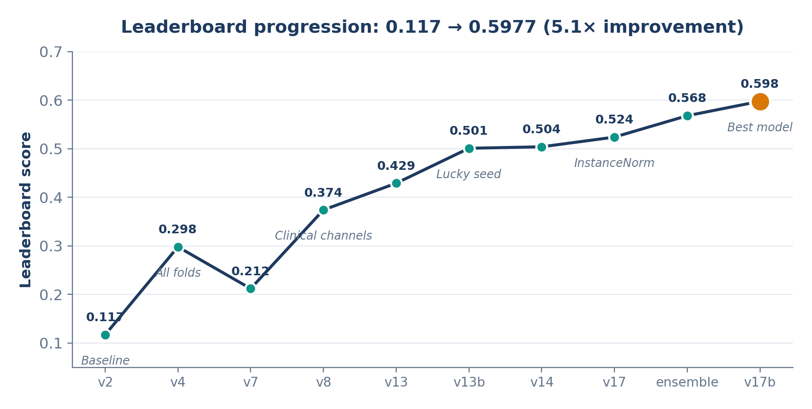
RESULTS
Results — Leaderboard Progression
5.1× improvement over 6 phases of model development
PHASE SUMMARY
P1
Getting it to work
0.117 → 0.298
P2
Clinical features
0.298 → 0.374
P3
ODELIA baseline
0.374 → 0.504
P4
Advanced techniques
0.504 ceiling
P5
InstanceNorm
→ 0.524
P6
Ensembling
→ 0.568
P7
IN + lucky seed
→ 0.598
Breast MRI Classification • ODELIA 2025 • TDT4265
13 / 18
Notes:
Zooming out, here's the full leaderboard trajectory over the whole project. Seven phases, 0.117 to 0.598 — a 5.1-fold improvement. The big jumps are where conceptual insights landed: moving to all folds, matching the ODELIA baseline, switching to InstanceNorm, combining it with the lucky seed. The plateaus are where I learned things that did not help — like MedicalNet pretraining or adaptive BatchNorm. The lesson is consistent: the cheapest changes gave the biggest gains, while adding model capacity gave diminishing returns.

Slide 14
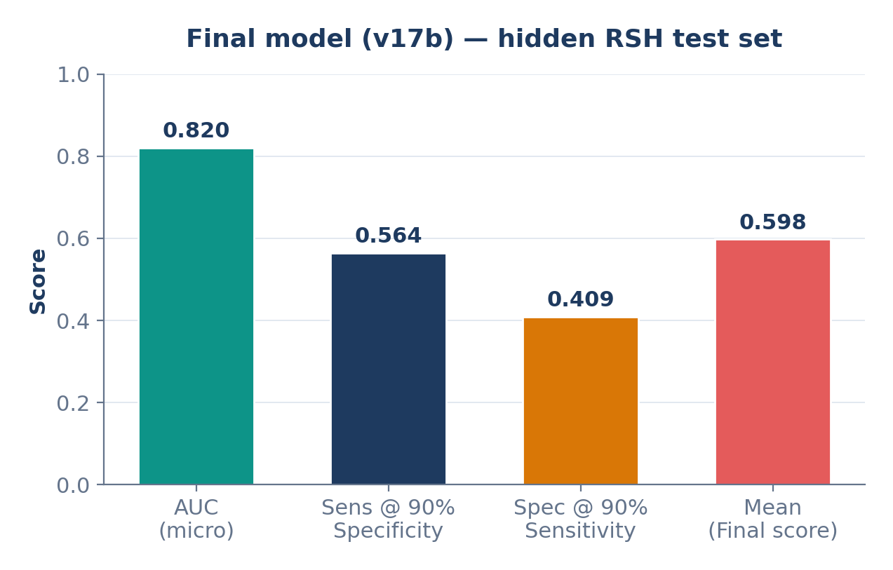
RESULTS
Results — Final Model Metrics
v17b on the hidden RSH leaderboard (66 unseen-center cases)
WHAT THE NUMBERS MEAN
▸ AUC 0.82 — strong discriminative power for malignant-vs-other, generalized across scanners.
▸ Sens@90%Spec = 0.56 — model catches 56% of malignant cases while keeping false positives low.
▸ Spec@90%Sens = 0.41 — our highest ever. Previous models topped out around 0.22.
▸ Final score 0.598 = mean of the three — competitive with top student submissions.
Breast MRI Classification • ODELIA 2025 • TDT4265
14 / 18
Notes:
And here are the component metrics on the hidden Riga set. AUC of 0.82 — strong discriminative power for malignant versus non-malignant. Sensitivity at 90 percent specificity is 0.56 — the model catches over half of malignant cases while keeping false positives bounded. Specificity at 90 percent sensitivity is 0.41, and this is where version 17b really stands out — my previous best models topped out around 0.22 on that metric. Final composite score is 0.598, the mean of those three, which is competitive with the top student submissions.

Slide 15
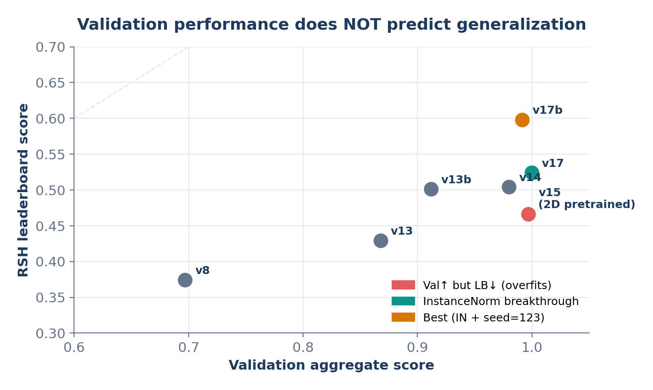
DISCUSSION
Discussion
Why validation lies, and why ensembling can hurt
THE DOMAIN SHIFT PROBLEM
▸ Val ≠ generalization. v15 had 0.997 val but worst leaderboard (0.466). Near-perfect val can signal overfitting to the training distribution.
▸ Ensembling backfired. v17b solo (0.598) > any ensemble. When one model dominates, averaging with weaker ones dilutes its specificity.
▸ AdaBN failed with n = 66. Too few target samples to reliably re-estimate BN statistics.
▸ Seed impact is large. With small data, initialization determines which loss-landscape minimum you land in. Seed=123 consistently found a more robust region.
Breast MRI Classification • ODELIA 2025 • TDT4265
15 / 18
Notes:
A few points that genuinely surprised me. First, validation does not predict leaderboard. Version 15 had 0.997 validation but the worst leaderboard of my top models. Near-perfect validation can actually signal overfitting to the training distribution. Second, ensembling backfired. Normally averaging models helps, but v17b solo beat every ensemble I tried. When one model dominates, mixing in weaker ones dilutes it. Third, I tested adaptive BatchNorm — updating BN statistics with unlabeled Riga images — and it made scores worse. 66 samples is too few for reliable statistics. Fourth, random seed impact is remarkably large with small data — plus seven percent from initialization alone, consistently.

Slide 16
KEY LEARNINGS
Key Learning Points
Five takeaways from building a multi-center medical classifier
01
Domain generalization is the hard problem
Achieving 98% val accuracy was easy. Getting 50%+ on RSH (unseen scanner) required rethinking normalization from BN to IN.
02
EDA-guided iteration beats hyperparameter tuning
Every version was motivated by a specific failure analysis. The path from 0.117 → 0.598 was NOT random search.
03
Clinical knowledge > architecture
Switching from 'all 5 sequences' to 'Sub_1 only' (v13) improved leaderboard more than any architecture change.
04
Validation performance can mislead
The correlation between val and RSH is weak. A model with lower val (v17b, 0.992) beat one with perfect val (v15, 0.997).
05
Seed matters (with small data)
+0.07 leaderboard from seed alone, consistent across architectures. Always train multiple seeds; don't trust a single run.
Breast MRI Classification • ODELIA 2025 • TDT4265
16 / 18
Notes:
Five takeaways worth remembering. One: domain generalization is the hard problem. Getting 98 percent validation accuracy was easy. Getting above 50 on the unseen Riga scanner required rethinking normalization from BatchNorm to InstanceNorm. Two: EDA-guided iteration beats hyperparameter sweeps. Every version I shipped was motivated by a specific failure, not a grid search. Three: clinical knowledge beat architecture changes. Switching from five channels to just Sub one was worth more than any backbone swap. Four: validation can mislead — always check the real test distribution. Five: with small data, always train multiple seeds. Plus seven percent from seed 123 was consistent across architectures — that's signal, not luck.

Slide 17
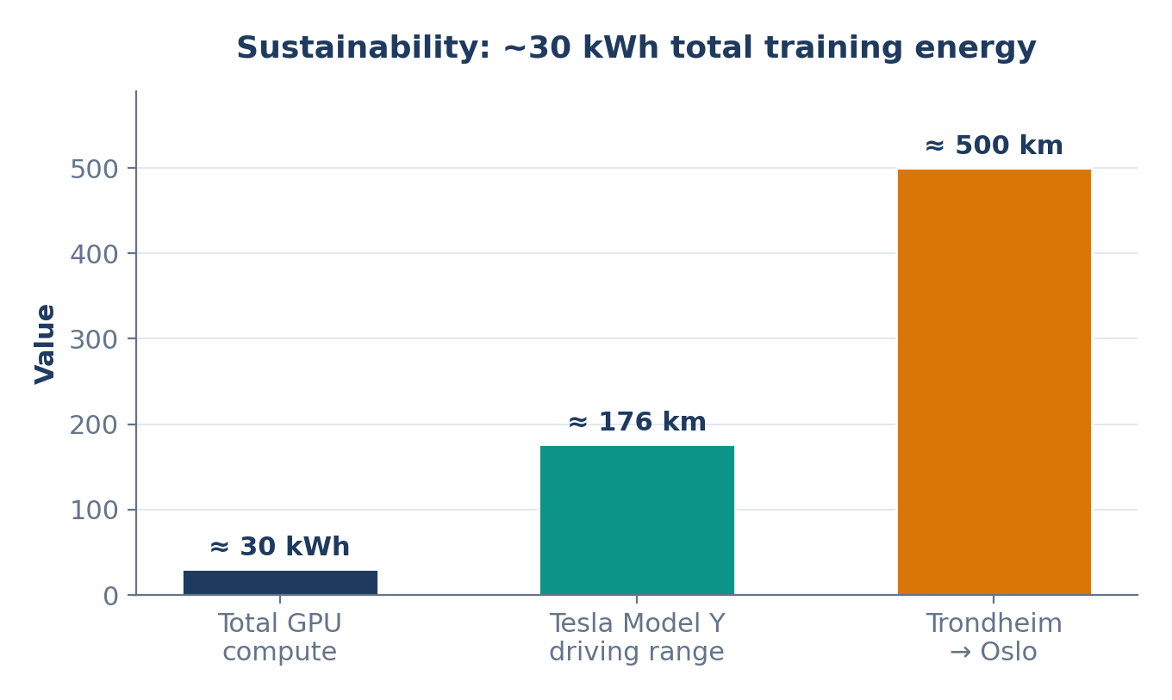
SUSTAINABILITY
Sustainability
Total compute energy vs a Tesla Model Y from Trondheim to Oslo
ENERGY ACCOUNTING
~100 h
A100 wall-clock across ~25 runs
~30 kWh
total GPU energy (A100 @ 300 W)
~176 km
Tesla Model Y range (0.17 kWh/km)
35 %
of the Trondheim → Oslo drive (~500 km)
TAKEAWAY
The full model-development journey cost about as much energy as driving a third of the way to Oslo — modest, but non-trivial when scaled to clinical deployment.
Breast MRI Classification • ODELIA 2025 • TDT4265
17 / 18
Notes:
On sustainability — about 100 hours of A100 wall-clock time across roughly 25 training runs. At 300 watts per GPU that's approximately 30 kilowatt-hours of energy. Converting via the Tesla Model Y reference of 0.17 kilowatt-hours per kilometer, that's about 176 kilometers of driving — roughly 35 percent of the Trondheim to Oslo trip. So the full development journey cost less energy than half a road trip. Modest by research standards, but worth tracking if you ever scale this kind of pipeline to actual clinical deployment across many hospitals.

Slide 18
REFERENCES
References
Challenge, dataset, frameworks, and key papers
CHALLENGE & DATASET
• ODELIA Challenge 2025 — odelia2025.grand-challenge.org
• ODELIA Consortium — odelia.ai
• A European Multi-Center Breast Cancer MRI Dataset — arXiv:2506.00474
METHODS & FRAMEWORKS
• MONAI: Medical Open Network for AI — monai.io
• Tencent MedicalNet: 3D pretrained ResNet for medical imaging (2019)
• Guo et al., On Calibration of Modern Neural Networks — ICML 2017
RELATED WORK (ODELIA ENTRIES)
• MeisenMeister — two-stage breast seg + classification — arXiv:2510.27326
• Mask-Guided SwinUNETR for breast MRI classification — arXiv:2508.20621
COURSE RESOURCES
• TDT4265 Mini-Project brief — NTNU (Frank Lindseth)
• IDUN HPC Cluster — hpc.ntnu.no/idun
Breast MRI Classification • ODELIA 2025 • TDT4265
18 / 18
Notes:
Final slide — references. The challenge and dataset papers, MONAI and MedicalNet for frameworks, Guo et al. on calibration, and the two top ODELIA entries — MeisenMeister and Mask-Guided SwinUNETR — which inspired several of my experiments. Plus the TDT4265 brief itself. Thanks for listening, and I'm happy to take questions.

